Slide 1

MediaTameen-Export Program
06\02\2018-14\04\2018
Professional Indemnity Insurance
Architects & Engineers
Mr. Mohammed Abu Zaid

Slide 2

Professional
Indemnity
Insurance
Architects & Engineers

Slide 3
Professional Liability Insurance (PLI).
Also called Professional Indemnity Insurance (PII).
BUT more commonly known as Errors & Omissions (E&O) in the US.

Slide 4
Form of Protection against Damages resulting from any Error and Omission to third parties resulting from consultancy / services / advise from any Professional entity or individual.

Slide 5
FOR WHO?

Slide 6


Slide 7


Slide 8


Slide 9


Slide 10


Slide 11


Slide 12
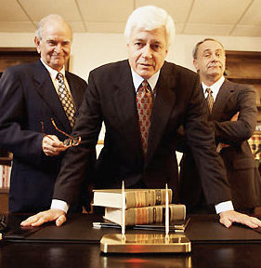

Slide 13


Slide 14


Slide 15
Professional Indemnity Types
Professional indemnity for architects and engineers.
Professional indemnity for doctors and hospitals.
Professional indemnity for accountants.
Professional Indemnity for any kind of consultancy.
Professional indemnity for financial brokers and insurance brokers .
Professional indemnity for lawyers.
Professional indemnity for computer specialists.
Any specified profession to be agreed by underwriter.

Slide 16
THREE
Related Factors Underpin This Growth In PI Insurance

Slide 17
NUMBER 1
More People seeking professional advise and third party support.

Slide 18
NUMBER 2
The availability of “after the event” legal expenses insurance and the use of contingency fees.

Slide 19
NUMBER 3
The requirement laid down by professional bodies that their members have PI insurance to defined minimum liability.

Slide 20
HOW does liability arise?

Slide 21
Duty of Care.
Breach of Duty of Care.
Loss or Damage due to that breach.
Legal Liability.

Slide 22
Definition
The insured’s legal liability due to breach of any agreed Profession by reason of any negligent act, error or omission committed or alleged to have been committed

Slide 23
Who is the Insured
Professional Business name (official commercial name) and their employees and any other affiliated offices related to the insured.
(If required and mentioned in the proposal form ).

Slide 24
Basis of Coverage
Annual Blanket Basis.
Single Project Basis.

Slide 25
Annual Cover
Cost reduction distributed on all projects.
Wider discovery period.

Slide 26
Single Project
Separate Guaranteed Long Lasting Cover.
Limit not shared with another projects.
More accurate pricing.

Slide 27
Proposal Form and Risk Underwriting
Scope of works.
Annual turnover.
Territorial limits.
Choice of law and Jurisdiction.

Slide 28
Proposal Form and Risk Underwriting
Experience & staff.
Limits of indemnity
Retroactive Date.
Deductible/Excess.

Slide 29
Legal Form & Structure
Stand Alone.
Sub-Consultant/s.
Joint Venture JV.

Slide 30
Extensions
Standard
  Loss of document.
  Loss of computer records.
  Dishonesty of employees.
  Libel and Slander.

Slide 31
Limits of Indemnity
Any one loss/ occurrence/ claims.
Aggregate limits during insurance period.

Slide 32
Risky Location & High Value / Concentration of Risk
High Limit per event.
Double amount for the policy aggregate.

Slide 33
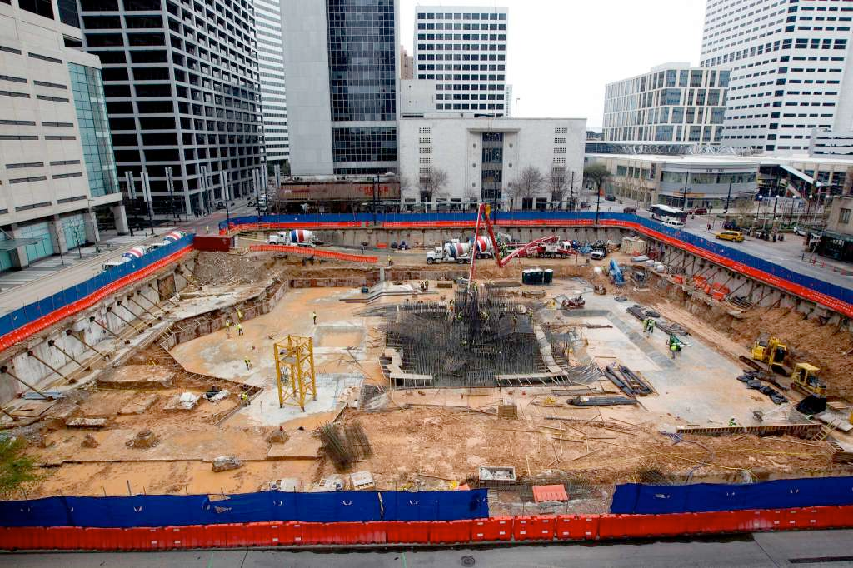

Slide 34
Litigation & Geographical Scope
Jurisdiction.
Geographical Limit

Slide 35


Slide 36
Claims Trigger
Claims Made / Claims Discovery.
Claims Occurrence.

Slide 37
Professional Indemnity Policy is a Claims Made policy
What is Retro-active date and its benefits?

Slide 38
Insurance Time Line
Retro-active Date
Period of Insurance
Reporting Period
Inception Date
1st of Jan
Expiry Date
31st of Dec

Slide 39
Some General Exclusions
Any negligent act, error or omission in connection with services or activities going beyond the scope of professional services typically performed as an architect and/or consulting engineer under domestic legislation, ethical codes and rules.

Slide 40
Any neglect, error or omission by the Insured in effecting or maintaining insurance or in providing finance or advice on financial matters.
Financial loss resulting from exceeding cost estimates and time limits.

Slide 41
Liability assumed by the Insured by contract or any other agreement or any express warranty or guarantee given by the Insured which increases the Insured's legal liability.
Any claim made against the Insured as the result of any intentional, dishonest, malicious, criminal or illegal act on the part of the Insured or his employees.

Slide 42
The ownership, use, occupation or lease of property, mobile or immobile, including waterborne vessel or craft or aircraft or motor vehicle, by, to, or on behalf of, the Insured.
Any liability of whatsoever nature, directly or indirectly caused or contributed to by, or arising from, pollution of air, water or soil.

Slide 43
Liability resulting from asbestos or any related disease (including cancer) resulting from the existence, production, handling, processing, manufacture, sale, distribution, storage, deposit or use of asbestos, asbestos products and/or products containing asbestos.

Slide 44
Any consequence of war, invasion, act of foreign enemy, hostilities (whether war be declared or not), civil war, terrorism, rebellion, revolution, insurrection or military or usurped power.

Slide 45

Liability due to force majeure (for example, but not limited to, earthquake and flood).
Fines, penalties, punitive or exemplary damages or any other damages resulting from the multiplication of compensatory damages.

Slide 46
The costs of revising or redesigning drawings, plans, specifications or schedules of specifications as a consequence of a claim indemnifiable.
Infringement of patents, copyrights, trade names, trade marks or registered design or the allocation of licenses.

Slide 47
Bodily injury sustained by any person arising out of and in the course of his employment by the insured under a contract of service or apprenticeship with the insured.

Slide 48
Claims failed by the insured under the policy against each other or filed by a party,
  Which is directly or indirectly owned, controlled, operated or managed by an insured,
  In which any insured is a partner, consultant or employee.

Slide 49
Loss or destruction due to :
  Ionizing radiations or contamination by radioactivity.
  The radioactive, toxic, explosive or other hazardous

Slide 50
Professional Liability vs Decennial Liability.
Professional Liability vs Directors &Officers Liability.

Slide 51

Thank You

